Slide 1
Perfect Competition
Management 405
Prof. Melanie Wasserman · UCLA Anderson

Slide 2
Perfect Competition · Announcements
Announcements
Problem sets
Problem Set 3, due Nov. 5
Management 405 · Perfect Competition
2

Slide 3
Perfect Competition · Course Roadmap
Agenda for the Class
1. The Economic Way of Thinking
2. Value and Demand
3. Supply and Cost
we are here
4. Markets, Pricing and Strategy
Management 405 · Perfect Competition
3

Slide 4
Perfect Competition · Outline
Outline
1
Introduction to market structures
2
Perfect competition
Profit maximization of a price taker in the short run · Long-run competitive equilibrium
3
Market distortions, regulations, externalities
Management 405 · Perfect Competition
4

Slide 5
Perfect Competition · Outline
Outline
1
Introduction to market structures
2
Perfect competition
Profit maximization of a price taker in the short run · Long-run competitive equilibrium
3
Market distortions, regulations, externalities
Management 405 · Perfect Competition
5

Slide 6
Perfect Competition · Introduction
The Four Basic Market Structures
Perfect Competition
Monopolistic Competition
Oligopoly
Monopoly
Number of firms
Many
Many
Few
One
Type of products sold
Identical
Differentiated
Identical or Differentiated
Unique
Barriers to entry
None
None
Some
Many
Management 405 · Perfect Competition
6

Slide 7
Perfect Competition · Outline
Outline
1
Introduction to market structures
2
Perfect competition
Profit maximization of a price taker in the short run · Long-run competitive equilibrium
3
Market distortions, regulations, externalities
Management 405 · Perfect Competition
7

Slide 8

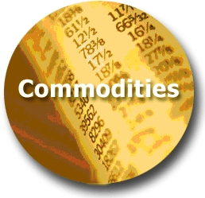



Perfect Competition · Introduction
Where We Are and Where We Are Going
Least Market Power
WE ARE HERE
Most Market Power
Perfect
Monopolistic
Oligopoly
Monopoly
Competition
Competition
(Price Takers)
(Price Searchers)
Restaurants in WeHo
Management 405 · Perfect Competition
8

Slide 9
Perfect Competition · Price Takers
Market Structure Characteristics
 | Perfect Competition – Price Takers
Number of actual or potential competitors | Many small sellers
Product differentiation | None
Entry conditions | No barriers
Profit potential | Short run: can be positive/negative/zero Long run: zero economic profit
Examples | Agricultural commodities; currency markets; unskilled labor
Management 405 · Perfect Competition
9
Notes:
Oligopoly means markets with few sellers, but more than one (which is monopoly). How few? What is the distinction between oligopoly and monopolistic competition?
There are barriers to entry in oligopolistic markets, keeping the number of competitors low and creating the potential for long term abnormal profits.
There is strategic interdependence in oligopoly: under monopolistic competition, each firm ignores price changes by other firms because each is so small their price behavior does not affect your behavior. Under oligopoly, each has an incentive to respond to others' deviations.
Examples of oligopoly include tobacco, satellite radio (before the merger), wide-bodied aircraft, and mobile phone services.

Slide 10
Perfect Competition · Price Takers
Perfect Competition: The Market and the Firm
Market
Firm (price taker)
Price ($)
Price ($)
S
Market
equilibrium
Demand curve d = Marginal Revenue (MR)
P*
P*
D
Quantity
Quantity
Management 405 · Perfect Competition
10
Notes:
This slides explain the relationship between the market vs. the firm demand. It shows where the demand a price taker is coming from = market price, determined by the market equilibrium.
Now, let’s turn to see how a price taker maximizes profit in the short run.

Slide 11

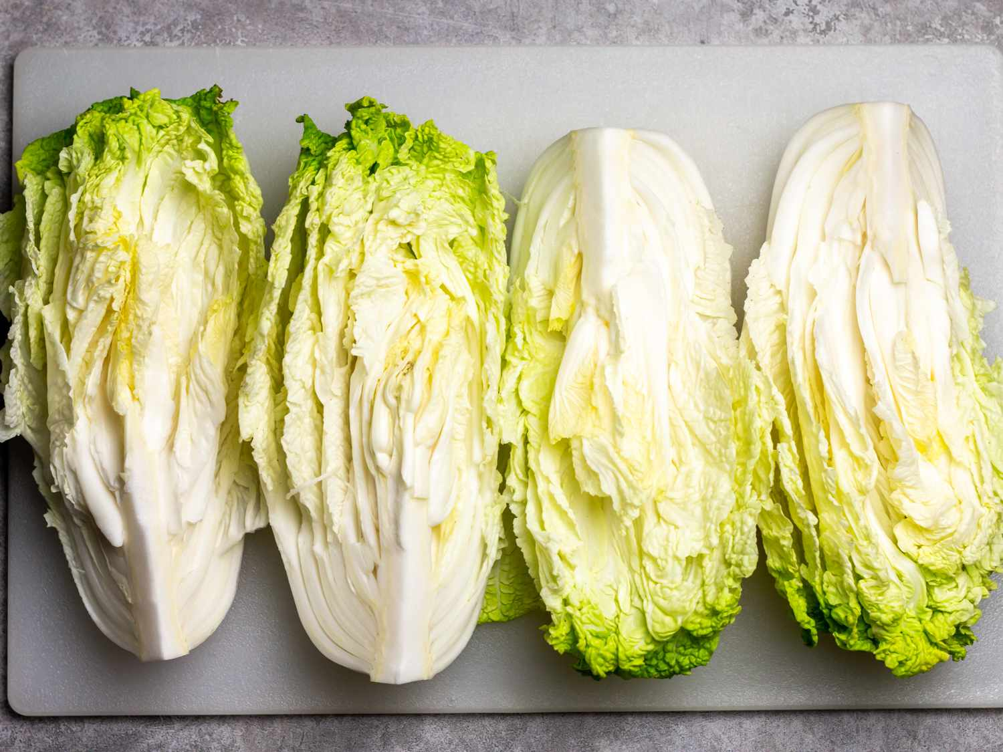
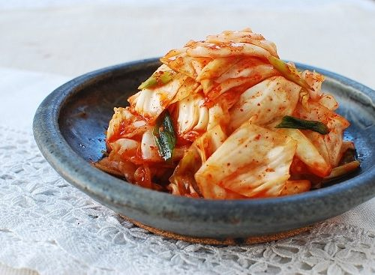
Perfect Competition · Price Takers
Example: The Yi family
South Korean family moves from California to rural Arkansas to start a family farm
Their goal: grow Korean produce to sell to vendors in Dallas
We focus on their cabbage production
Yi Family Example
Management 405 · Perfect Competition
11
Notes:
https://www.vulture.com/article/minari-movie-review-a-gentle-immigrant-drama-set-in-u-s.html
https://time.com/5938842/minari-korean-american-farmers/

Slide 12
Perfect Competition · Price Takers
Business Relevance
Key questions:
Should the Yi family operate or not?
1
How much should the Yi family produce to maximize profits?
2
We start by analyzing the second: profit maximization
Key concept: marginal analysis
Yi Family Example
Management 405 · Perfect Competition
12

Slide 13
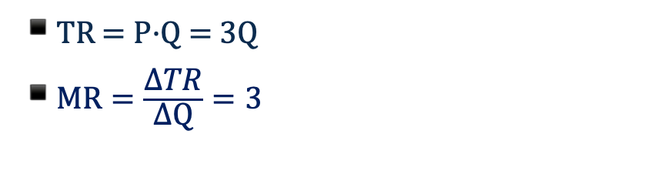
Perfect Competition · Price Takers
Price Taker Revenue Conditions
P
Q
TR
MR
TR ($)
P ($)
$3
10
$30
$3
TR = P·Q
3
11
33
3
3
12
36
3
30
3
13
39
3
$\text{T}\text{R}\text{ = }\text{P}\text{·}\text{Q}\text{ = 3}\text{Q}$
$MR=\frac{\text{Δ}\text{TR}}{\text{Δ}\text{Q}}=3$
Demand curve d = P = Marginal Revenue (MR)
3
10
Quantity
Yi Family Example
Management 405 · Perfect Competition
13

Slide 14
Perfect Competition · Profit Maximization
Price Taker Profit Maximization
Set MR = MC (true for all profit maximizers!)
However, MR is easier to compute, MR = P
P fixed (market price)
Only decision: how much to produce
Set Q* such that MC = P
➜
Management 405 · Perfect Competition
14

Slide 15
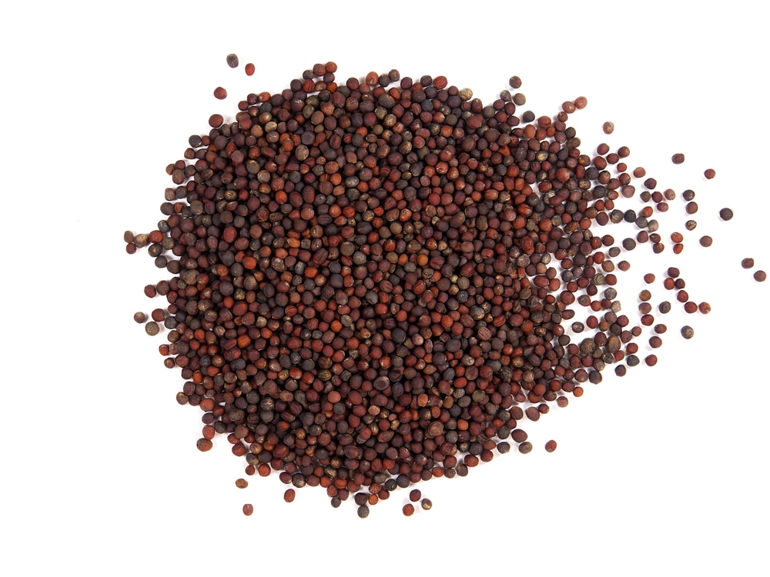
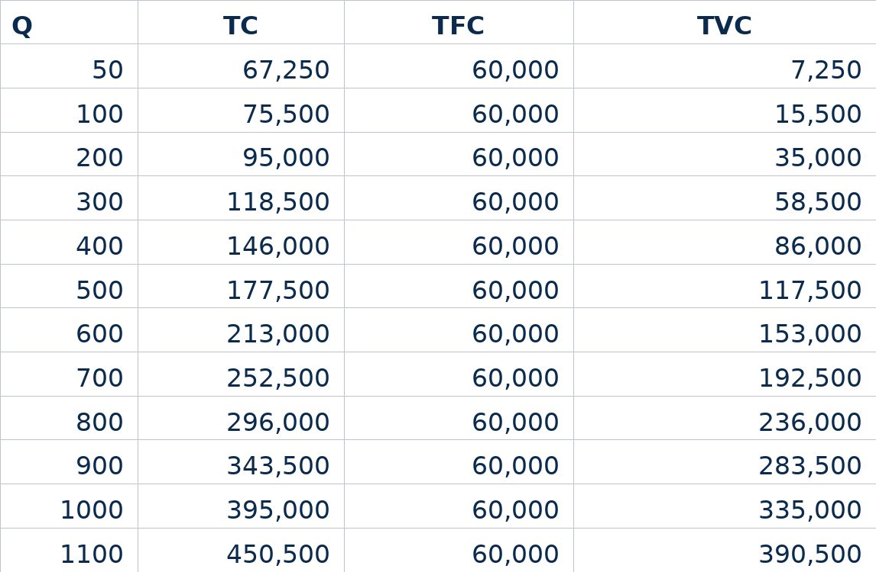


Perfect Competition · Profit Maximization
Cabbage Production Costs
Q | TC | TFC | TVC
50 | 67,250 | 60,000 | 7,250
200 | 95,000 | 60,000 | 35,000
400 | 146,000 | 60,000 | 86,000
600 | 213,000 | 60,000 | 153,000
800 | 296,000 | 60,000 | 236,000
1000 | 395,000 | 60,000 | 335,000
Yi Family Example
Management 405 · Perfect Competition
15

Slide 16
Perfect Competition · Profit Maximization
Cabbage Total Cost Function
TC = 60,000 + 135Q + 0.2Q²
Yi Family Example
Management 405 · Perfect Competition
16

Slide 17
Perfect Competition · Profit Maximization
Maximizing Profit: Cabbage Production
The Yi family has the following total cost function:
TC = 60,000 + 135Q + 0.2Q²
Q is the quantity produced (in tons)
The market price of cabbage is $400 per ton
How many tons should the Yi family produce to maximize profits?
Group Exercise
Management 405 · Perfect Competition
17

Slide 18
Perfect Competition · Profit Maximization
Profit Maximizing Quantity: Solution
We need to set MR = MC
MC: derivative of TC with respect to Q
TC = 60,000 + 135Q + 0.2Q²
ΔTC
MC =
= 135 + 0.4Q
ΔQ
MR: the market is perfectly competitive, so MR is the market price
MR = P = 400
135 + 0.4Q = 400
MR = MC
Q* = 662.5 tons
Yi Family Example
Management 405 · Perfect Competition
18

Slide 19
Perfect Competition · Profit Maximization
Profit maximization of a Price Taker: Visual Representation
Firm revenue, cost, and profit ($)
TR
TC
TR Slope = MR = P
TC Slope = MC
Maximum profit
Profit = TR-TC
TFC
Q*
Quantity (Q)
Management 405 · Perfect Competition
19

Slide 20
Perfect Competition · Profit Maximization
Two Ways to Write Profit
1
Profit
= TR − TC
= (P · Q ) − (ATC · Q )
= (P − ATC ) · Q
Management 405 · Perfect Competition
20

Slide 21
Perfect Competition · Profit Maximization
Computing Profits
Profit = (P − ATC ) · Q
Profit is positive if P ≥ ATC
What is the economic profit of the Yi family at the profit-maximizing output level (Q* = 662.5) ?
Q* = 662.5 using MR=MC
P = 400
Yi Family Example
Management 405 · Perfect Competition
21

Slide 22
Perfect Competition · Profit Maximization
Profit at Q*: Solution
Profit = TR − TC
TR = P · Q = 400 · 662.5 = 265,000
TC = 60,000 + 135 · 662.5 + 0.2 · 662.5² = 237,218.75
Profit = 265,000 − 237,218.75 = 27,781.25
Profit = (P − ATC ) · Q
–
ATC =
TC
=
237,218.75
= 358.066
Q
662.5
Profit = (400 − 358.066) · 662.5 = 27,781.25
The Yi family makes positive economic profit at the optimal output level
Yi Family Example
Management 405 · Perfect Competition
22

Slide 23
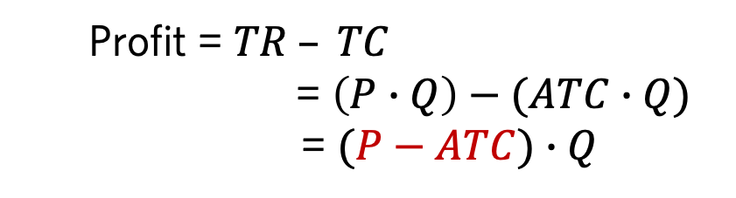
Perfect Competition · Profit Maximization
Maximizing Profits in the Short Run: General Case
Positive Profit
Zero Profit
Negative Profit (Loss)
Price & cost ($/unit)
Price & cost ($/unit)
Price & cost ($/unit)
Loss, π <0
ATC
MC
MC
MC
Profit, π > 0
Average total cost ATC
ATC
ATC*
P
d = MR
ATC* = P
d = MR
P
d = MR
ATC*
Q*
Quantity
Q*
Quantity
Q*
Quantity
Profit = $TR – TC$
= $\left(P∙Q\right)−(ATC∙Q)$
= $(P−ATC)∙Q$
Management 405 · Perfect Competition
23
Notes:
To measure profit, we subtract total cost from total revenue.
Profit = TR – TC
We can rewrite this as:
Profit = P*Q – ATC*Q
Profit = (P – ATC)*Q
This formula determines whether the firm has positive, zero, or negative profit.
Positive profit: In this figure, the firm’s total revenue is the area of the rectangle with height P and width Q*. The total cost is the area of the rectangle with the height ATC* and the width Q*. Because total revenue exceeds total costs at Q*, the firm is earning positive profits. This equation tells us that profit is positive when P>ATC at the profit maximizing quantity Q*.
Zero profit: Here P=ATC (=MC). We know that MC intersects ATC at its minimum.
Negative profit: P<ATC

Slide 24
Perfect Competition · Profit Maximization
If Profit is Negative, Should a Firm Shut Down?
Is a firm better off operating at a loss or shutting down and producing zero output?
Shutting down: Long run vs. Short run
Long run: exit the industry
Short run: still need to pay for the fixed costs
e.g., land rental contract for the year
We first focus on short-run decisions
Management 405 · Perfect Competition
24

Slide 25
Perfect Competition · Profit Maximization
Two Ways to Write Profit
1
Profit
= TR − TC
= (P · Q ) − (ATC · Q )
= (P − ATC ) · Q
2
Profit
= TR − TC
= PQ − TVC − TFC
= P · Q − AVC · Q − TFC
= (P − AVC ) · Q − TFC
Management 405 · Perfect Competition
25

Slide 26
Perfect Competition · Profit Maximization
In the Short Run, If Profit Is Negative, Should a Firm Shut Down Temporarily?
Profit = Q · (P − AVC) − TFC
Operate if P ≥ AVC
Shut down if P < AVC
Option 1: Shut down (but need to pay for the fixed costs)
Loss = −TFC
Option 2: Operate
Loss = Q · (P − AVC) − TFC
If P ≥ AVC, the loss is lower than TFC
If P < AVC, the loss is larger than TFC
Management 405 · Perfect Competition
26

Slide 27
Perfect Competition · Profit Maximization
Optimizing in the Short Run: New Market Price
The US starts importing large quantities of cabbage from China
This leads to a drop in the US market price
New price is $210 per ton
Remember: TC = 60,000 + 135Q + 0.2Q²
Questions
1. What quantity of cabbage should the Yi family produce to maximize profits under this new price?
2. What profits do they achieve at this quantity?
3. Should the Yi family continue to operate in the short run?
Yi Family Example
(Group exercise)
Management 405 · Perfect Competition
27

Slide 28
Perfect Competition · Profit Maximization
New Q* and Profit: Solution
MC=MR=P
135 + 0.4Q = 210 → Q * = 187.5
TR = P · Q = 210 · 187.5 = 39,375
TC = 60,000 + 135 · 187.5 + 0.2 · 187.5 ² = 92,343.75
Profit = 39,375 − 92,343.75 = −52,968.75
The Yi family makes negative economic profit at the optimal output level
Yi Family Example
Management 405 · Perfect Competition
28

Slide 29
Perfect Competition · Profit Maximization
Decision to Operate: Solution
TC = 60,000 + 135Q + 0.2Q ²
P = 210, Q * = 187.5
135Q + 0.2Q ²
= 135 + 0.2Q
AVC =
Q
AVC at the profit maximizing quantity = 172.5
P > AVC → the Yi family should continue to operate in the short run
Yi Family Example
Management 405 · Perfect Competition
29

Slide 30
Perfect Competition · Profit Maximization
High Price: Positive Profits in the Short Run
$/Q
MC
ATC
AVC
Profit
P_{High}
P=MR
Q*
Q
Optimal output is where MC = MR = P. This occurs at Q*.
At that output positive economic profits are being made because P > ATC.
Management 405 · Perfect Competition
30

Slide 31
Perfect Competition · Profit Maximization
Low Price: Operating at a Loss in the Short Run
$/Q
MC
ATC
AVC
Loss
P_{Low}
P=MR
Q*
Q
Negative economic profits (losses) are being made because P < ATC.
But P ≥ AVC → The firm should continue to operate in the short run.
Management 405 · Perfect Competition
31

Slide 32
Perfect Competition · Profit Maximization
Very Low Price: Shutting Down in the Short Run
$/Q
MC
ATC
AVC
Loss
P_{Very low}
P=MR
Q*
Q
Negative economic profits (losses) are being made because P < ATC.
P < AVC → The firm should shut down; operating does not positively contribute to recover TFC.
Management 405 · Perfect Competition
32

Slide 33
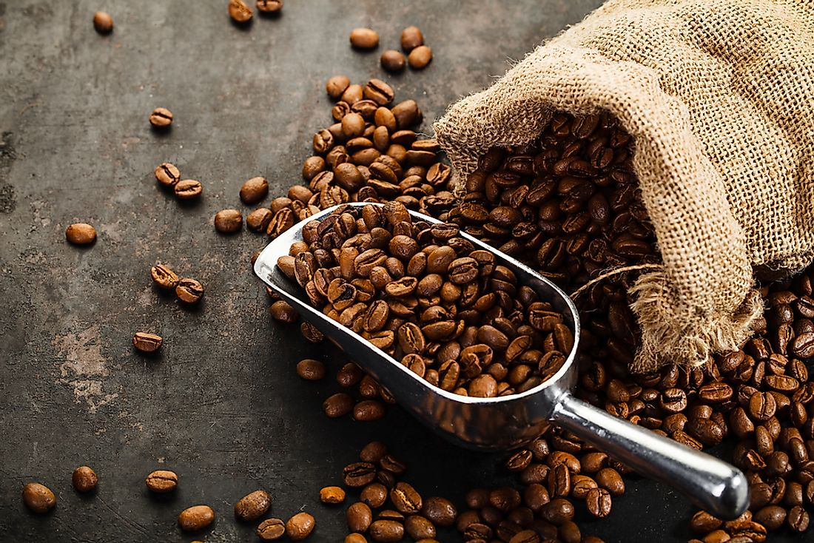

Perfect Competition · Profit Maximization
Coffee Bean Producer
Your firm is a price taker in the coffee bean market.
Your goal is to maximize profits in the short run
You have recently optimized your output level.
AVC = $12
ATC = $15
MC = $10
Should you continue to operate in the short run?
PollEV
Management 405 · Perfect Competition
33

Slide 34
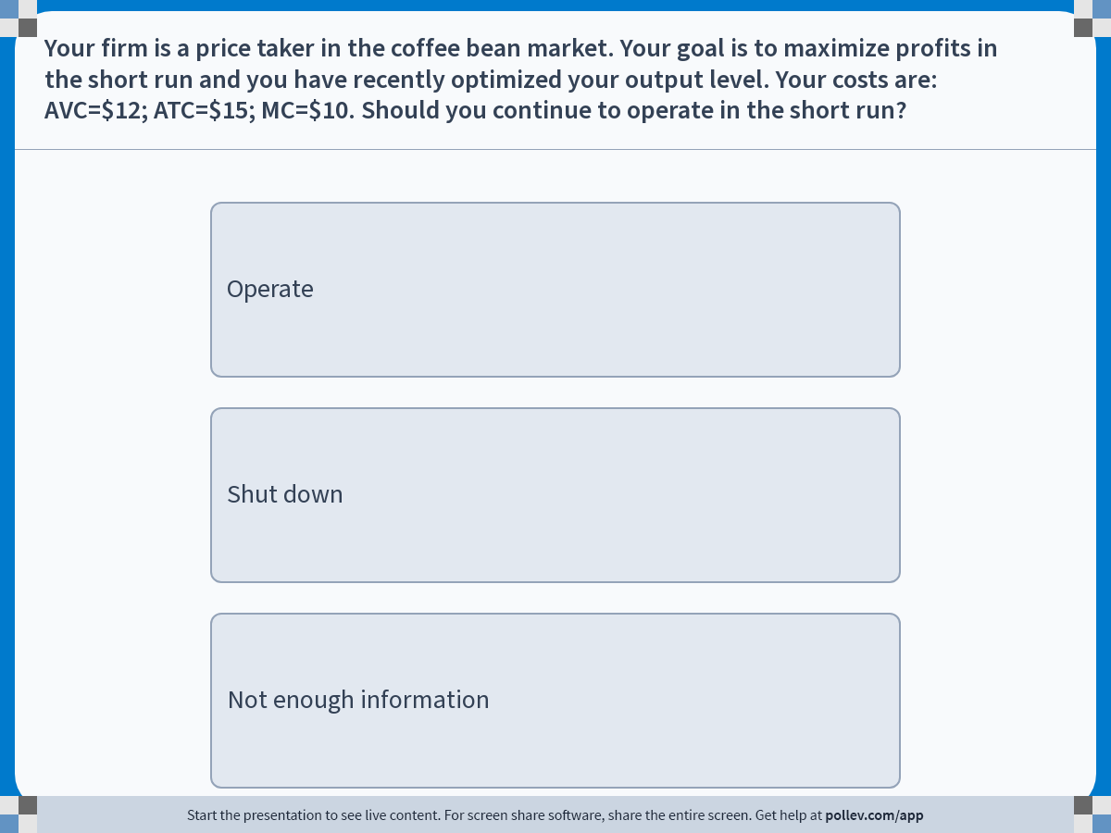
Perfect Competition · PollEV
Poll
PollEV
Management 405 · Perfect Competition
34
Notes:
Do not modify the notes in this section to avoid tampering with the Poll Everywhere activity.
More info at polleverywhere.com/support
Your firm is a price taker in the coffee bean market. Your goal is to maximize profits in the short run and you have recently optimized your output level. Your costs are: AVC=$12; ATC=$15; MC=$10. Should you continue to operate in the short run?
https://www.polleverywhere.com/multiple_choice_polls/MgZ3JgEwyNMXzPDT3jMAO?display_state=instructions&activity_state=opened&state=opened&flow=Engagement&onscreen=persist

Slide 35
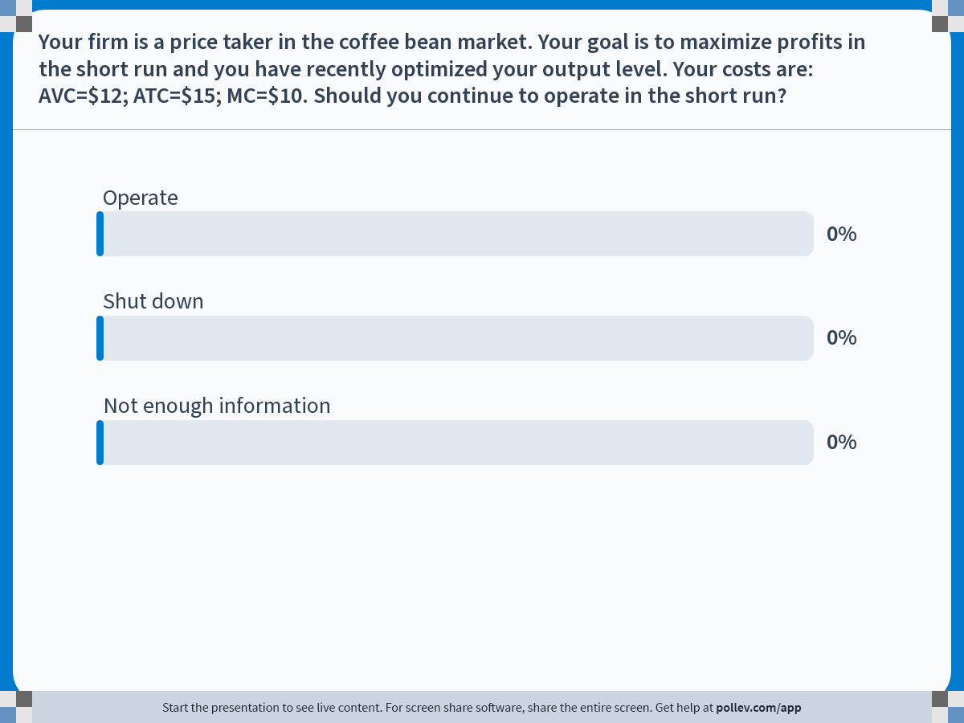
Perfect Competition · PollEV
Poll
PollEV
Management 405 · Perfect Competition
35
Notes:
Do not modify the notes in this section to avoid tampering with the Poll Everywhere activity.
More info at polleverywhere.com/support
Your firm is a price taker in the coffee bean market. Your goal is to maximize profits in the short run and you have recently optimized your output level. Your costs are: AVC=$12; ATC=$15; MC=$10. Should you continue to operate in the short run?
https://www.polleverywhere.com/multiple_choice_polls/MgZ3JgEwyNMXzPDT3jMAO?display_state=chart&activity_state=opened&state=opened&flow=Engagement&onscreen=persist

Slide 36
Perfect Competition · Profit Maximization
Coffee Bean Producer: Solution
Current level of output is profit-maximizing implies that MR = MC
We know that MC = 10, so MR = 10, and the market price must also be $10
Since AVC = 12, we have that P < AVC
This means you are losing money on every unit sold. You should shut down.
Management 405 · Perfect Competition
36

Slide 37
Perfect Competition · Profit Maximization
Summary: Short-Run Decisions for a Price Taker
Optimal output level: Q* where MC = MR = P
If P ≥ AVC at Q*: Operate
1
Profits at Q* can be negative or positive
Positive profits if P ≥ ATC
Negative profits if P < ATC
If P < AVC at Q*: Shut down
2
Losses = TFC
If you continued to produce, your losses would be higher than TFC
➜ PS 3, #2
Management 405 · Perfect Competition
37

Slide 38
Perfect Competition · Profit Maximization
Price Taker’s Short Run Supply Curve
MC curve is the firm’s short run supply curve
Price
Price
MC
S
230
AVC
160
40
300
475
Q
300
475
Q
Management 405 · Perfect Competition
38

Slide 39
Perfect Competition · Profit Maximization
The Effect of Changing Marginal Costs on a Firm’s Supply
$
MC₀
MC₁
P = MR
High-yield seeds
q
q₀
q₁
Management 405 · Perfect Competition
39

Slide 40
Perfect Competition · Profit Maximization
Firm and Market Dynamics When MC Falls
New high-yield seeds arrive on the market
Market
Firm (farmer)
P
P
MC₀
MC₁
S₀
S₁
P₀
MR₀ = P₀
P1
MR₁ = P₁
D
Q₀
Q₁
Q
q₀
q₂
q₁
q
Management 405 · Perfect Competition
40

Slide 41
Perfect Competition · Outline
Outline
1
Introduction to market structures
2
Perfect competition
Profit maximization of a price taker in the short run · Long-run competitive equilibrium
3
Market distortions, regulations, externalities
Management 405 · Perfect Competition
41

Slide 42
Perfect Competition · Long-Run Equilibrium
Perfect Competition in the Long Run
What changes?
Can choose whether to incur fixed costs (e.g. rent, salaried employees)
Focus on Long Run Average Costs (LAC)
Market entry and exit
Affect the market price
Management 405 · Perfect Competition
42
Notes:
Notes from the book: because all inputs and costs are variable in the long run, the firm’s long-run supply curve is the part of its long-run marginal cost curve above its long-run average total cost curve ( LATC=LAVC because there are no fixed costs in the long run).
Yi example: in the long run they can decide whether or not to rent the land + how much land to rent

Slide 43
Perfect Competition · Long-Run Equilibrium
Long Run Competitive Equilibrium (assuming there are many identical producers)
$/Q
LMC
LAC
P₁
MR=P₁
Entry
P_{LR}
MR=P_{LR}
Exit
P₂
MR=P₂
Q₂
Q_{LR}
Q₁
Q
At Q_{LR}, P = LAC = LMC
Management 405 · Perfect Competition
43

Slide 44
Perfect Competition · Long-Run Equilibrium
Long Run Equilibrium: Drug Market
Can we use our toolbox to analyze the drug market?
Assume: individual drug dealers are price takers
Suppose that the government has two options to tackle the drug problem:
1. Arrest drug dealers (one time)
2. Arrest / punish drug users (one time)
Which policy is more promising if the aim is to eradicate drugs?
Management 405 · Perfect Competition
44

Slide 45
Perfect Competition · Long-Run Equilibrium
Comparison of Effects
Arrest drug dealers
Deter consumers
1. Supply declines
2. Market price goes up
3. Dealers make profits
4. New dealers enter
5. Go back to the old equilibrium
1. Demand declines
2. Market price goes down
3. Dealers make losses
4. Dealers exit
5. New equilibrium with lower quantity
Management 405 · Perfect Competition
45

Slide 46
Perfect Competition · Long-Run Market Equilibrium
Summary: Long-Run Decisions for a Price Taker
Optimal output level: Q* where LMC = MR = P
1. If P ≥ LAC at Q*: operate
Positive profits, so other firms will enter in the long run
2. If P < LAC at Q*: exit the market permanently or do not enter in the first place
Long run competitive equilibrium: LMC = P = LAC
“Normal profits”: economic profits are zero in the long run
Management 405 · Perfect Competition
44

Slide 47
Perfect Competition · Outline
Outline
1
Introduction to market structures
2
Perfect competition
Profit maximization of a price taker in the short run · Long-run competitive equilibrium
3
Market distortions, regulations, externalities
Management 405 · Perfect Competition
45

Slide 48
Perfect Competition · Market Distortions
Market Distortions
In competitive markets, equilibrium given by intersection of supply and demand curves
External forces can distort equilibrium:
Price controls
Taxes and subsidies
How to assess who benefits and who loses?
Consumer and Producer Surplus
Deadweight loss
Management 405 · Perfect Competition
46

Slide 49
Perfection Competition · Surplus
Consumer Surplus
CS: difference between the consumers’ willingness to pay (D curve) and the actual price (P*)
P
S
Consumer surplus (CS) is the area below the demand curve and above the price line
CS
P*
D
Q*
Q
Management 405 · Perfect Competition
47

Slide 50
Perfection Competition · Surplus
Producer Surplus
PS: difference between the price at which producers are willing to sell (S curve) and the price producers actually receive for their goods (P*)
P
S
Producer surplus (PS) is the area above the supply curve and below the price line
P*
PS
D
Q*
Q
Management 405 · Perfect Competition
48

Slide 51
Perfect Competition · Price Controls
Deadweight Loss
Inefficiencies that arise under market intervention
Loss of mutually beneficial transactions
e.g., workers willing to work at the free market wage and firms willing to hire them
Deadweight loss:
Welfare (CS + PS)_{Free Market} − Welfare (CS + PS)_{Regulation}
Management 405 · Perfect Competition
49

Slide 52
Perfect Competition · Price Controls
Price Floor: Minimum Wage
Wage
Welfare effects:
Some workers win A
Some workers lose C
Firms lose A + B
Deadweight loss B + C
L_{S}
w_{min}
A
B
w*
C
Circumvention?
Underground labor market
Cutting non-wage benefits
Unpaid internships
L_{D}
L_{d}
L*
L_{s}
Labor
L_{s} − L_{d} = unemployment
Management 405 · Perfect Competition
50

Slide 53
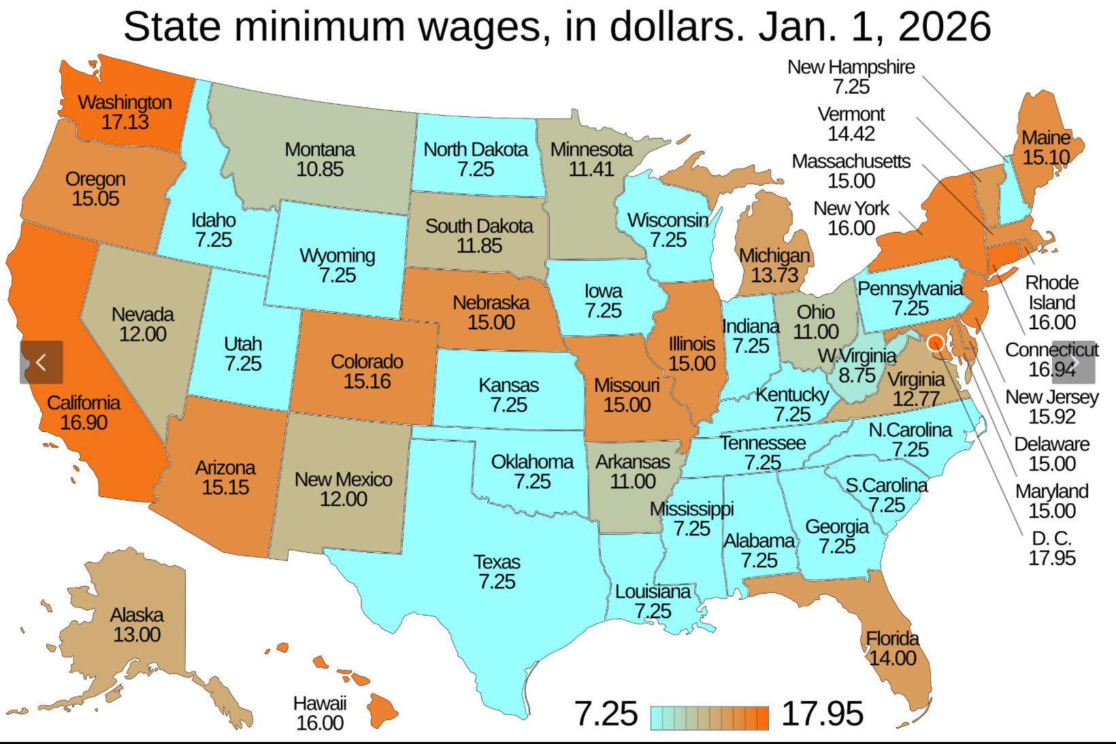
Perfect Competition · Market Distortions
The Minimum Wage: A Popular Policy Tool
Class discussion
Source: Wikipedia
Management 405 · Perfect Competition
51

Slide 54
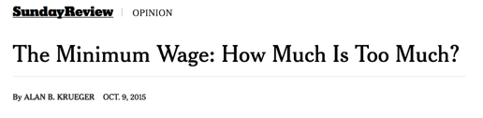
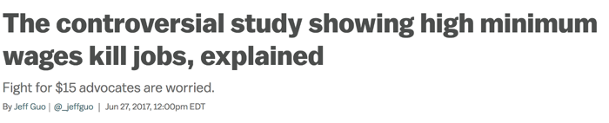
Perfect Competition · Market Distortions
The Minimum Wage: How Much Is Too Much?
Conflicting evidence on the effects of the minimum wage
“Natural” experiments: changes to state and city minimum wages
Early evidence: No effect on employment, except teen employment
Even the authors of the study remain cautious, however
More recent evidence
The minimum wage: how much is too much? From the perspective of…
Business owners?
Workers?
Consumers?
Class discussion
Management 405 · Perfect Competition
52

Slide 55

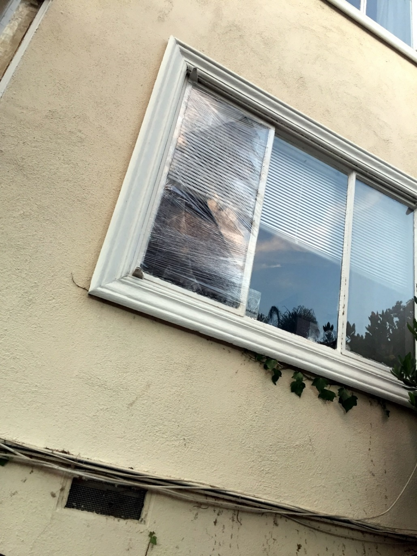
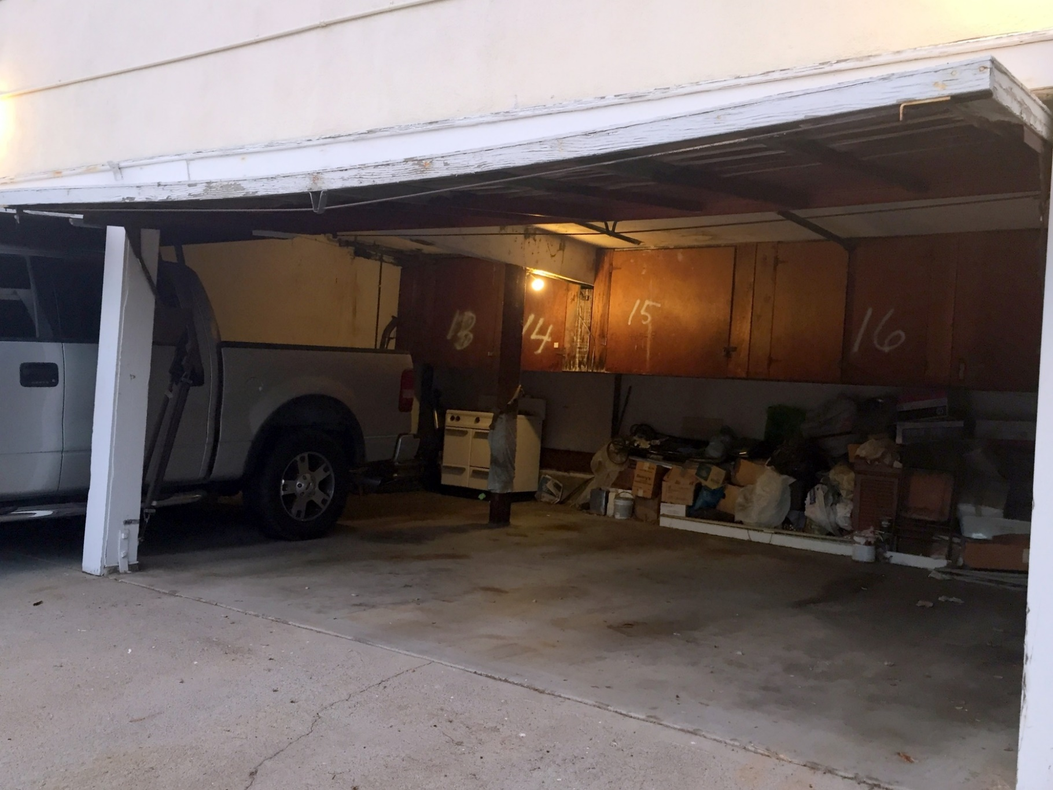

Perfect Competition · PollEV
Poll: Where is this?
PollEV
Management 405 · Perfect Competition
53

Slide 56
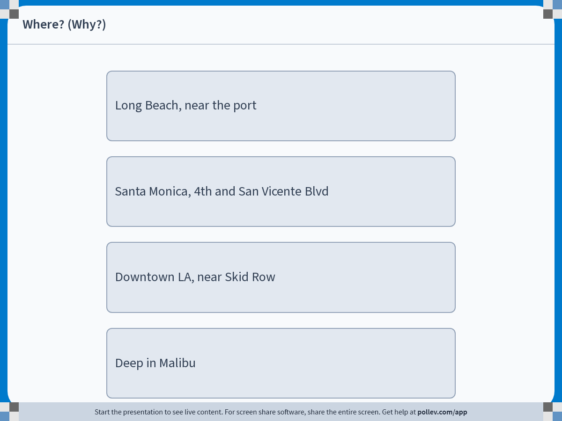
Perfect Competition · PollEV
Poll
PollEV
Management 405 · Perfect Competition
54
Notes:
Do not modify the notes in this section to avoid tampering with the Poll Everywhere activity.
More info at polleverywhere.com/support
Where? (Why?)
https://www.polleverywhere.com/multiple_choice_polls/kqkSWxCsJQNjYnTxvAOPF?display_state=instructions&activity_state=opened&state=opened&flow=Engagement&onscreen=persist

Slide 57
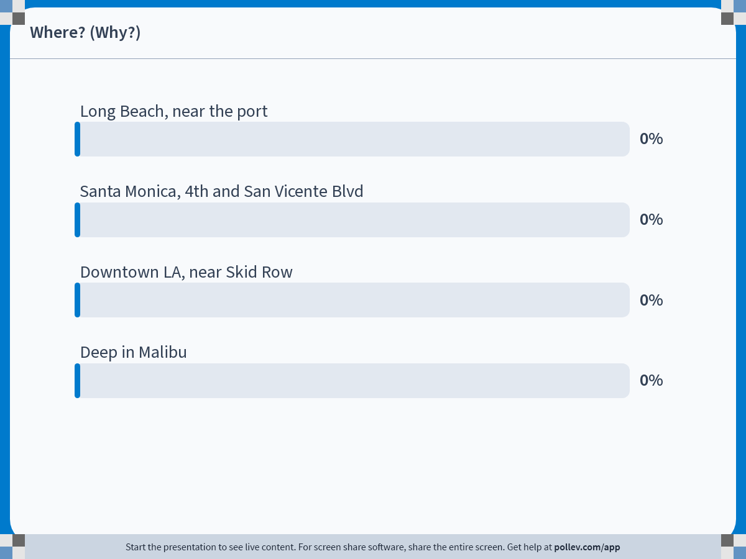
Perfect Competition · PollEV
Poll
PollEV
Management 405 · Perfect Competition
55
Notes:
Do not modify the notes in this section to avoid tampering with the Poll Everywhere activity.
More info at polleverywhere.com/support
Where? (Why?)
https://www.polleverywhere.com/multiple_choice_polls/kqkSWxCsJQNjYnTxvAOPF?display_state=chart&activity_state=opened&state=opened&flow=Engagement&onscreen=persist

Slide 58
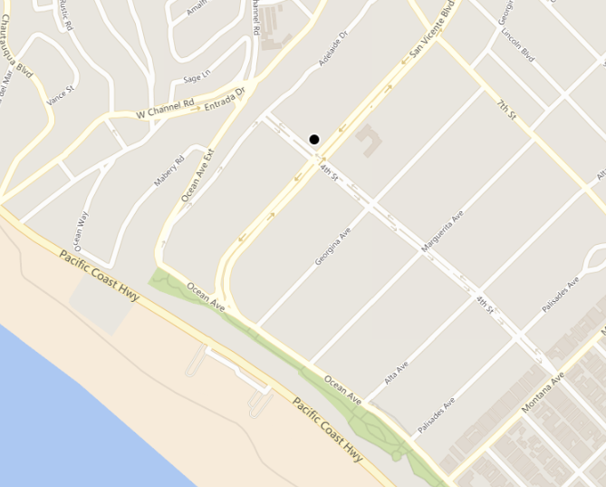
Perfect Competition · Market Distortions
Poll: What is the Rent?
1 Bed, 1 Bath
900 sqft
401 San Vicente Blvd., Santa Monica
5-minute walk to the beach
Best public school district in West LA
PollEV
Management 405 · Perfect Competition
56

Slide 59
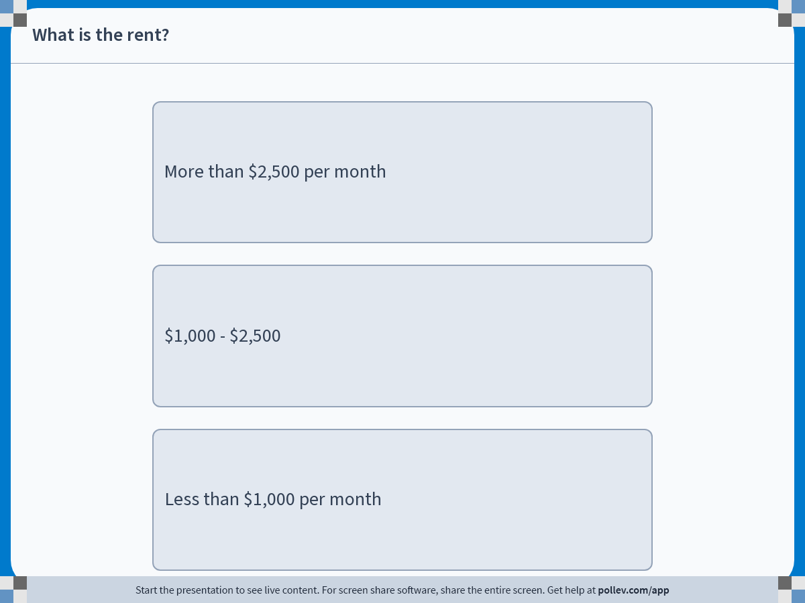
Perfect Competition · PollEV
Poll
PollEV
Management 405 · Perfect Competition
57
Notes:
Do not modify the notes in this section to avoid tampering with the Poll Everywhere activity.
More info at polleverywhere.com/support
What is the rent?
https://www.polleverywhere.com/multiple_choice_polls/lUVCBDEJcA5zFN6W7fTd3?display_state=instructions&activity_state=opened&state=opened&flow=Engagement&onscreen=persist

Slide 60
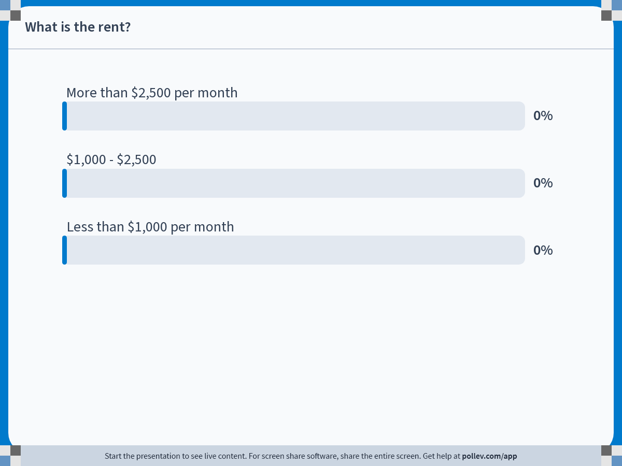
Perfect Competition · PollEV
Poll
PollEV
Management 405 · Perfect Competition
58
Notes:
Do not modify the notes in this section to avoid tampering with the Poll Everywhere activity.
More info at polleverywhere.com/support
What is the rent?
https://www.polleverywhere.com/multiple_choice_polls/lUVCBDEJcA5zFN6W7fTd3?display_state=chart&activity_state=opened&state=opened&flow=Engagement&onscreen=persist

Slide 61
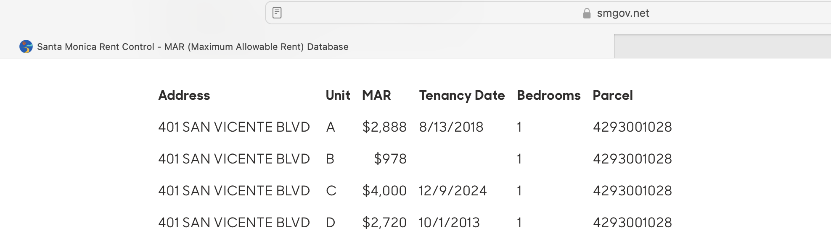
Perfect Competition · Market Distortions
What is the Rent?
Management 405 · Perfect Competition
59

Slide 62
Perfect Competition · Market Distortions
Price Ceiling: Rent Control
Welfare effects:
Some renters win A
Some renters lose B
Landlords lose A + C
Deadweight loss: B + C
P
S
B
P*
A
C
How do landlords react?
Non-price adjustments (e.g., maintenance)
Buy out the tenants (legal)
Harass the tenants (illegal!)
P_{max}
D
Q_{s}
Q*
Q_{d}
Q
Q_{d} − Q_{s} = shortage
Management 405 · Perfect Competition
60

Slide 63

Perfect Competition · Market Distortions
Evidence on Rent Control
“Natural” experiment: sudden end of rent control in Cambridge, MA in 1995: Source: Autor, Palmer, Pathak (2014)
Rental price for previously rent-controlled units:
Investment in previously rent-controlled units:
Price/investment for nearby never-controlled units:
More recently:
⬆️
⬆️
⬆️
Management 405 · Perfect Competition
64
Notes:
The geography of residential properties and rent control in Cambridge, Massachusetts. Cambridge residential properties as of 2008 are marked with gray circles. Plots that were rent controlled as of 1994 are overlaid with black circles.

Slide 64
Perfect Competition · Market Distortions
Market Distortions: Per-Unit Sales Tax
The price paid to seller (P_{S}) drops. The total price paid by the buyer (P_{B}, inclusive of tax) increases, but by less than the tax.
$ per gallon of gasoline
S
P_{B}
The buyers lose A + B
The sellers lose C + D
Deadweight loss: B + D
The government gets A + C
A
B
P_{B}−P_{S}=t
P₀
C
D
P_{S}
D₀
D₁
Q₁
Q₀
Gallons of gasoline
➜ PS 3, #4
Management 405 · Perfect Competition
65

Slide 65
Perfect Competition · Market Distortions
Tax Incidence
Tax incidence/burden: the group (consumers or producers) that ultimately bears the burden of the tax
The payer does not matter
It does not depend on whether the consumers or the suppliers send the money
It depends on the supply and demand elasticities
The group who is the least price responsive will bear the higher share of the tax burden
Management 405 · Perfect Competition
66

Slide 66
Perfect Competition · Externalities
Externalities: Definitions
Externalities: A cost or benefit that affects a party not directly involved in a transaction
Negative externality: A cost imposed on a party not directly involved in a transaction
Example: air pollution from coal-fired power plants
Positive externality: A benefit conferred on a party not directly involved in a transaction
Example: A beekeeper's bees not only produce honey but can help neighboring farmers by pollinating crops
Management 405 · Perfect Competition
67

Slide 67

Perfect Competition · Externalities
Correcting for Externalities
Goal of the intervention: move a market with externalities toward the efficient outcome
Price Mechanisms: Tax or Subsidies
Quantity Mechanisms: Quota
Regulation mandating that the production or consumption of a certain quantity of a good or externality be limited (negative externality) or required (positive externality)
Management 405 · Perfect Competition
68

Slide 68
Perfect Competition · Externalities
Negative Externalities: Gas
$/gallon
Social marginal cost
SMC=MC₁+EMC
Supply = Internal
marginal cost (MC₁)
EMC
P_{Ext}
P_{Market}
External marginal
cost (“EMC”)
1.5
Demand
Q_{Ext}
Q_{Market}
Gallons of gasoline
per year
Management 405 · Perfect Competition
69

Slide 69
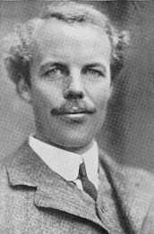


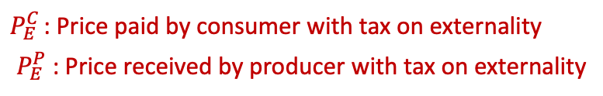

Perfect Competition · Externalities
Carbon Tax to Correct for the Negative Externality
External marginal cost (“EMC”) of gasoline is $1.50 per gallon
Arthur Pigou
$/gallon
MC₁+ Tax = SMC
Supply = Internal
marginal cost (MC₁)
Tax =EMC ($1.50)
$P_{E}^{C}$= 5.5
$P_{E}^{C}$ : Price paid by consumer with tax on externality
$P_{E}^{P}$ : Price received by producer with tax on externality
$P_{M}^{}$= 4.5
$P_{E}^{P}$= 4.0
External marginal
cost (“EMC”)
1.5
Demand
Q_{Ext}
Q_{Market}
Gallons of gasoline per year
Management 405 · Perfect Competition
70

Slide 70
Perfect Competition · Summary
Module 4 Summary
Perfect competition: price taker, MR=P
Profit maximization: MC=MR=P → Q*
Decision to operate in the short run
Operate if P ≥ AVC
Shut Down if P < AVC
Decision to operate in the long run
Operate if P ≥ LAC
Exit/do not enter if P < LAC
Long run competitive equilibrium: P = LMC = LAC
Market distortions, regulations, externalities
Winners, Losers, Deadweight loss
Management 405 · Perfect Competition
71

